Slide 1
Amazon Sales Report
Pournima Kamble

Slide 2
Introduction
Problem Statement
Overview
Key Objectives
Conclusion

Slide 3
Introduction
Amazon sales dashboard developed using Power BI.
This dashboard is designed to provide a comprehensive overview of
Sales Performance
Product Analysis
Fulfillment metrics
Customer Segmentation
Geographical Sales Distribution

Slide 4
Problem Statement
01
The provided dataset contains information about sales transactions on Amazon
The objective is to conduct a comprehensive analysis of the data and extract actionable insights to support business decision-making.

Slide 5
Overview
Key Metrics (Displayed as Cards)
129K
78.59M
50.30M
117K
Total Customers
Total Sales
Total Revenue
Total Product Sold

Slide 6
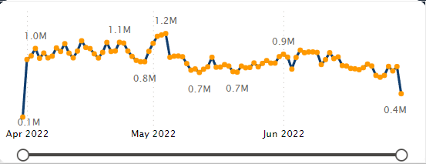
Sales Overview
Visualization: Line Chart
Details: This chart shows sales trends by year, quarter, and month.
Key Insights:
Highest Sales: May 4, 2022 (Quarter 2) with $12M in sales.
Lowest Sales: March 31, 2022 (Quarter 1) with $1M in sales.
Implication: The significant peak in Q2 indicates a successful sales period, potentially due to seasonal promotions or marketing campaigns, whereas Q1's low could signal a post-holiday sales slump.

Slide 7
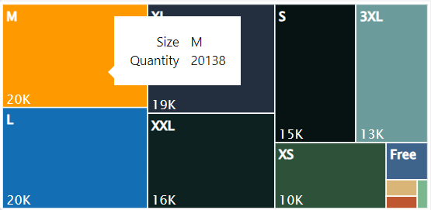
Product Analysis
Visualization: Tree Map
Details: This map showcases the popularity of product sizes.
Key Insights:
Highest Quantity Sold: M size with 20,138 units.
Lowest Quantity Sold: 4XL size with 398 units.
Implication: Medium-sized products are in high demand, suggesting inventory focus should be on popular sizes to maximize sales.

Slide 8
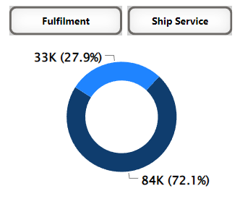
Fulfillment Analysis
Visualizations: Donut Chart and Stacked Column Chart
Details: These charts represent the distribution of product fulfillment.
Key Insights:
Merchant Fulfilled: 27.9% (33k units)
Amazon Fulfilled: 72.1% (84k units)
Implication: The majority of sales are fulfilled by Amazon, which might indicate better customer trust and preference for Amazon's fulfillment services due to reliability and speed.

Slide 9
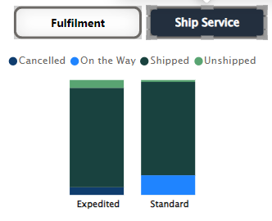
Fulfillment Analysis
Implications
High Shipped Rate for Expedited Service: With 86.55% of expedited orders shipped, it indicates a strong performance in fulfilling expedited delivery promises, which enhances customer satisfaction and trust.
Low Unshipped Rate for Standard Service: Only 1.62% of standard orders are unshipped, suggesting efficiency in standard shipping processes.
Opportunities for Improvement:
Expedited Service: The 6.65% cancellation rate and 6.8% unshipped rate in expedited orders highlight areas for process improvement to reduce cancellations and ensure timely fulfillment.
Standard Service: The 17.03% of orders that are 'on the way' suggest a need to monitor transit times and possibly improve delivery speed to match customer expectations.

Slide 10
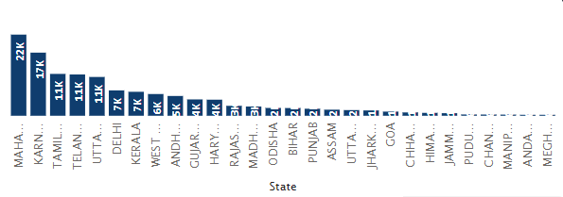
Customer Segmentation
Visualization: Bar Chart
Details: This chart shows the number of customers by state.
Key Insights:
Highest Buyers: Maharashtra (22k buyers)
Second Highest: Karnataka (17k buyers)
Third Highest: [State] with (11k buyers)
Implication: Understanding customer distribution helps tailor marketing strategies and inventory management to regions with the highest demand.

Slide 11
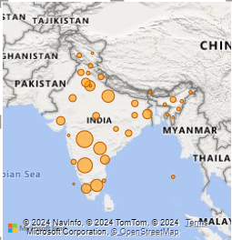
Geographical Analysis
Visualization: Map Chart
Details: This chart displays the percentage of total sales by state.
Key Insights:
Provides a visual representation of sales distribution, highlighting key regions driving the most revenue.
Implication: Geographical insights can help in strategic planning for expansion and targeted advertising in high-performing areas.

Slide 12

Thank You !

